Slide 1
Stealth game
Project idea by Zach Freeman

Slide 2
Motivation
Learning experience with a 2D game
Learning from doing rather than just tutorial
Prototype my actual game idea

Slide 3


Proposal
Make a 2D stealth game for android, something like gunpoint or mark of the ninja Made primarily in Unity or Game Maker Studio

Slide 4
App Features
Touch controls
Hold to charge jump in any direction
Left and right parts of screen for movement
Single player
Multiple levels
Different gadgets and abilities
Replayable levels

Slide 5
Phone Requirements
Unity: OS 4.1 or later; ARMv7 CPU with NEON support or Atom CPU; OpenGL ES 2.0 or later.
Game Maker Studio: Android 2.3, dedicated gpu with OpenGL 1.1 or higher
Memory Space

Slide 6
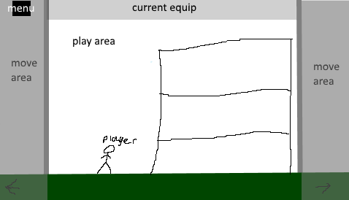
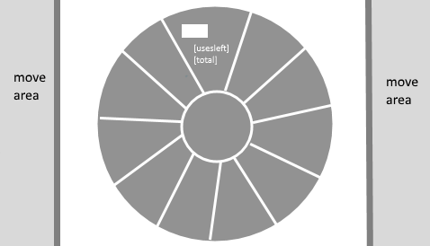
Mockups
Player would click and on self to jump, charge jump
Player could click and hold on equipment to pull and wheel and pause

Slide 7
Project Timeline
Project begins officially March 22? Due by April 30. 38 days to work.

Slide 8
Project Milestones
Milestone 0: Basic art assets Milestone 1: Workable Stealth AI Milestone 2: Basic Player Mechanics & Controls Milestone 3: First Level Built Milestone 4: Second Level … more levels
Optional: More equipment and abilities expanding upon basic ones More art assets?? Sound Design????? Story???????????????

Slide 9
Project Deliverables
At least one working stealth level balanced with basic game mechanics

